Slide 1
The Magnetized Dusty Plasma Experiment (MDPX)
Bob Merlino
Plasma Seminar
April 13, 2015

Slide 2
Background
The MDPX is an dusty plasma device at Auburn University (AL) designed to study dusty plasmas in magnetic fields up to 4 T.
Discussions began in November 2008 at the APS Plasma Meeting
The goal is to study the structural, thermal, and stability properties of a dusty plasma in which the magnetic force on dust is comparable to electrical, gravitational, or interparticle interaction forces.
Its construction was funded in 2011 by a $2.1M NSF MRI grant based on a collaborative proposal submitted by:
  Auburn University [Ed Thomas (PI) and Uwe Konopka]
  The University of Iowa (me)
  The University of California at San Diego (Marlene Rosenberg)
It is a multi-user research facility for the international dusty plasma community
It was formally commissioned in May of 2014, and is 66% operational
Ongoing operations are funded by DOE and NSF

Slide 3
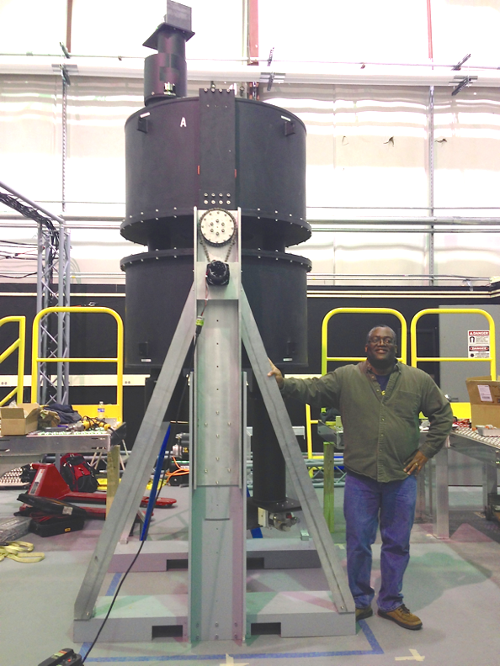

Slide 4
Why study magnetized dusty plasmas?
Astrophysics – charged, magnetized dust thought to play an important role in star formation (Mestel and Spitzer, MNRAS 116, 503, 1956)
Solar system –
  Dust streams emanating from Jupiter
  Planetary ring systems
Magnetic fusion –
  micron size pieces of material (Be, Fe, C, Ni, W) ablated and re-condensed from device walls usually during disruptions and then recirculated by device shaking. Can be detrimental to plasma, and poses critical safety issue (absorption of tritium).
  ITER – toroidal field 13 T → “dust” will have gyroradii ~ meter, minor radius is 2.8 m, so dust transport affected by the magnetic field
Scientifically interesting, technically challenging, but feasible!

Slide 5
Magnetic force on a charged particle →
(q/m)_{electron} = 1.76 x 10¹¹ C/kg
(q/m)_{proton} = 5.4 x 10⁻⁴ (q/m)_{electron}
For a dust particle of radius a = 0.5 μm in a typical lab plasma:
q » -2000e, m » 10⁻¹⁵ kg
(q/m)_{dust} = 1.8 x 10⁻¹² (e/m_{e}) [ (q/m)_{dust} µ 1/a²]
Shortly, the conditions under which a dust particle can be considered “magnetized” will be discussed

Slide 6
Questions to investigate in MDPX
Dust in a magnetized plasma (electrons and ions magnetized, dust not)
  How is charging process modified?
  How is Debye screening modified?
  Is the ion wake effect modified?
  How are the forces on dust, e.g. ion drag, modified?
  Rotation of dust clouds due to E x B ion drifts
  Effects of B on the formation and structure of dust crystals
  How are dust acoustic waves modified in magnetized plasma
Study dusty plasmas with paramagnetic or ferromagnetic particles in uniform and non-uniform B fields, effect of ÑB force
Magnetized dust effects
  Observe dust gyromotion**
  g || B or g ^ B (g x B drifts)
  New dust wave modes when dust is magnetized, e.g., electrostatic dust cyclotron waves

Slide 7
Dust charging for B = 0
The usual theory used to compute the dust charge assumes that the process is isotropic – electrons and ions can be collected by the particle from all directions
Currents to a particle of radius = a in a plasma having densities n_{e} = n_{i}
More electrons get to particle initially, so V_{f} < 0 → electrons are repelled and ions are attracted to the dust particle
Particle is floating, so in equilibrium, I_{e} + I_{i} = 0 → V_{f,eq}
Treat dust as spherical capacitor → q_{d} = (4πε_{o}a)V_{f,eq}

Slide 8
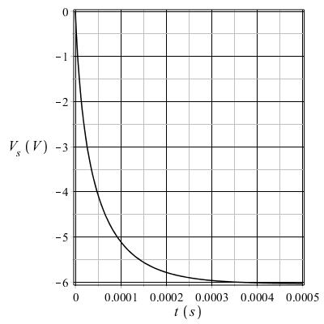
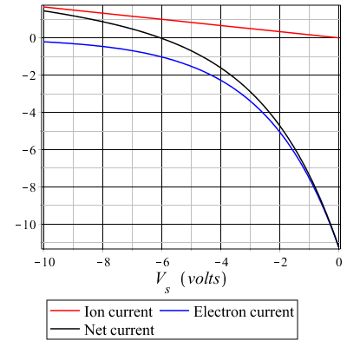
a = 0.5 μm, T_{e} =100 T_{i} = 2.5 eV, n =10¹⁴ m⁻³
Currents (arb)
V_{f} (V)
V_{f} (V)

Slide 9
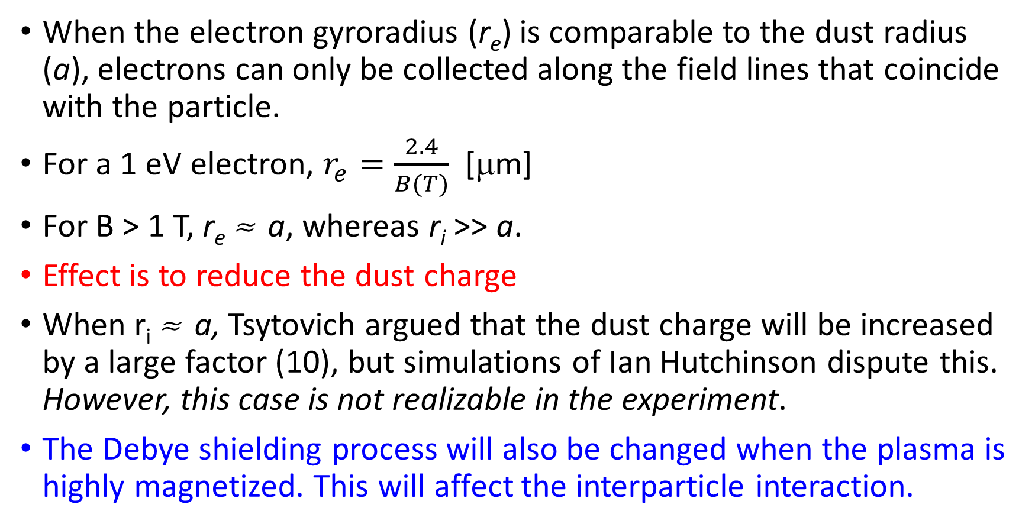
Dust charging and shielding when B ≠ 0
When the electron gyroradius (r_{e}) is comparable to the dust radius (a), electrons can only be collected along the field lines that coincide with the particle.
For a 1 eV electron, $r_{e}=\frac{2.4}{B(T)}$ [μm]
For B > 1 T, r_{e} » a, whereas r_{i} >> a.
Effect is to reduce the dust charge
When r_{i} » a, Tsytovich argued that the dust charge will be increased by a large factor (10), but simulations of Ian Hutchinson dispute this. However, this case is not realizable in the experiment.
The Debye shielding process will also be changed when the plasma is highly magnetized. This will affect the interparticle interaction.

Slide 10
** Observation of particle gyromotion
A diagnostic for the particle charge:
If gyromotion can be observed, both r_{cd} and v_{d⊥} can be determined
Since dust radius a is known, m_{d} is known
➔ q_{d} can be determined
This may require using particles of 100 nm radius

Slide 11
Criteria for dust magnetization
Two conditions must be met to have a “magnetized” dust particle:
  L is the system size
  r_{cd} is the dust cyclotron radius
  ω_{cd} is the dust cyclotron frequency
  ν_{dn} is the dust-neutral collision frequency (Epstein drag)
Is there a set of parameters for which both α and β can be << 1?
Yes!

Slide 12
Parameters and scalings
a = dust radius, q_{d} = dust charge, m_{d} = (4π/3)ρa³ = dust mass, v_{d} = dust speed
m_{n} is the mass of gas atoms, v_{Tn} = gas thermal speed
N(P) = gas density, P = gas pressure
The conditions for magnetization can be met using
small particles, high magnetic fields, and low pressures.

Slide 13
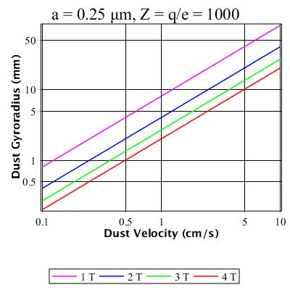
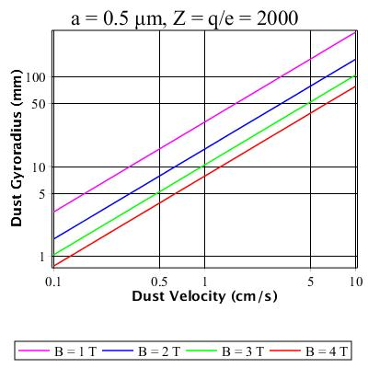
Dust gyro-radius vs. Dust Velocity

Slide 14
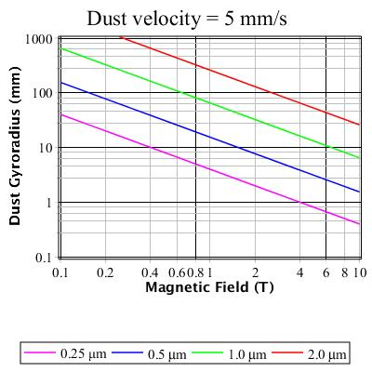
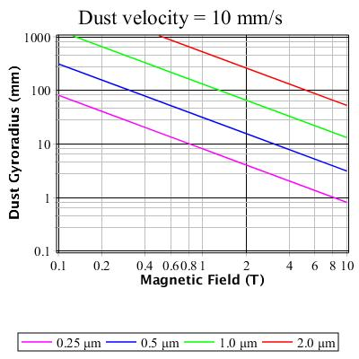
Dust gyro-radius vs. magnetic field strength

Slide 15
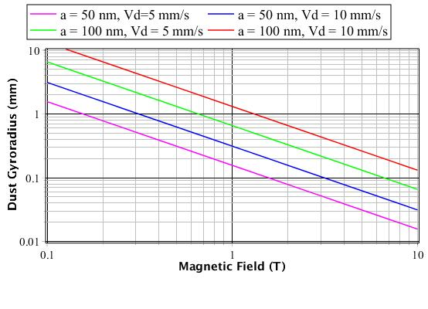
50 nm and 100 nm dust

Slide 16
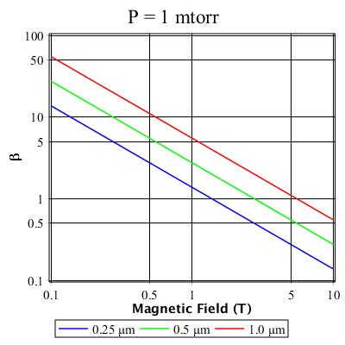
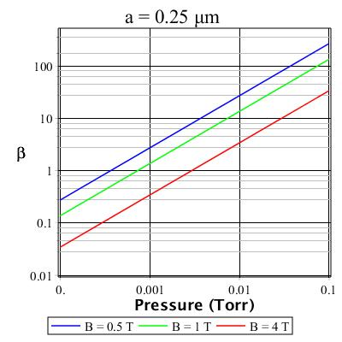
Dust collisionality effects
β
β

Slide 17
Particle size considerations
The ability to produce magnetized dust at reasonable magnetic field strengths requires the use of small particles
However, we would also like to be able to image the particles via Mie scattering using visible light**
This places a practical lower limit on the diameter of the particles to be no smaller than a typical laser wavelength – 532 nm = 0.532 μm
→ dust radius a > 0.25 μm
**The use of UV lasers (266 nm) and cameras with peak quantum efficiency in the UV have been considered for imaging of particles in the size range of 100 nm.

Slide 18
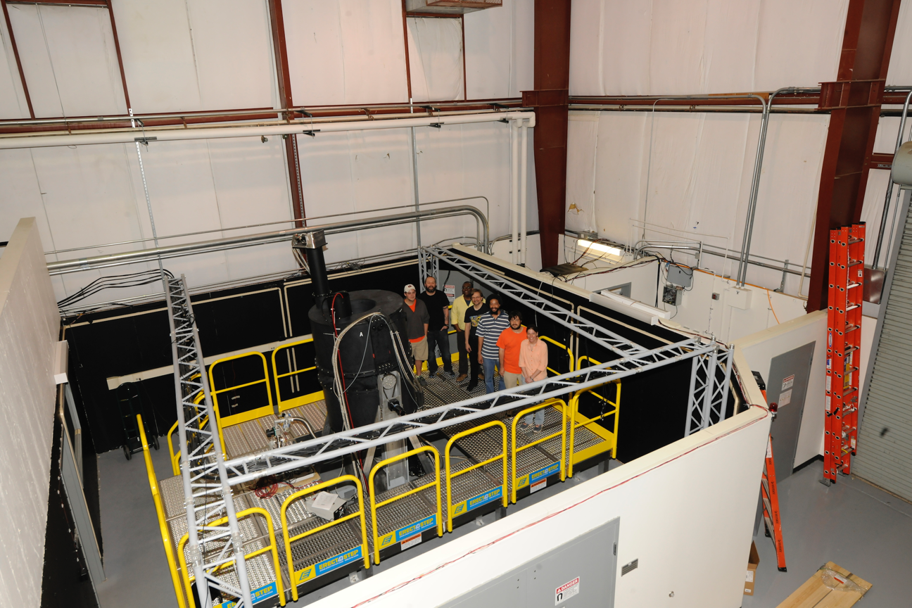
Hardware
Superconducting
magnets – power and cooling
Vacuum system
Plasma production
Diagnostics
Safety and control systems
Data acquisition and archiving systems

Slide 19
Superconducting magnets and cryostat
125 cm
4 coils wound using Niobium-Titanium wires embedded in a copper core
Cryogenically cooled to 4.6 K- 4.2 K
Designed by MIT Fusion Engineering Group and built by Superconducting Systems Inc. (SSI) in Billerica, MA
Maximum field = 4 T using 128 A
Open bore to allow access to chamber
Rotatable → g || B or g ^ B
Programmable currents to provide for uniform field, gradient of 2T/m, or cusp field with B = 0 in center
160 cm
19 cm
50 cm

Slide 20
Magnetic field configurations
Uniform B ÑB Cusp
Currently, the magnet is operating at the 2.5 T level, during the break- in period, under monitoring by the
manufacturer, SSI.
Over the next year, the magnet will gradually be ramped-up to full power at the 4 T level.

Slide 21
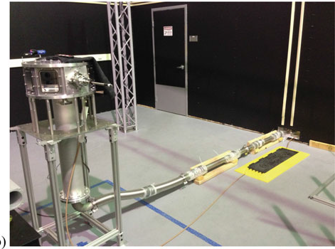
Vacuum chamber octagonal, aluminum
43 cm
20 cm
Vendor
Kurt J. Lesker Company

Slide 22
Plasma generation
Parameter | Value
Pressure | 1-250 mTorr
Plasma density | 10¹⁴ – 10¹⁵ m⁻³
T_{e} T_{i} | 2-4 eV 0.025 eV
Ion Debye length | 0.04 mm
Ion-neutral mfp | 0.06 mm (0.1 Torr)
Ion gyroradius | 0.1 mm (1 T)
Parallel plate configuration, Al disks 34 cm diameter, separation 6 cm
Lower electrode powered by 1 – 20 W, RF @ 13.56 MHz, and/or 5 kV, 25 mA DC

Slide 23
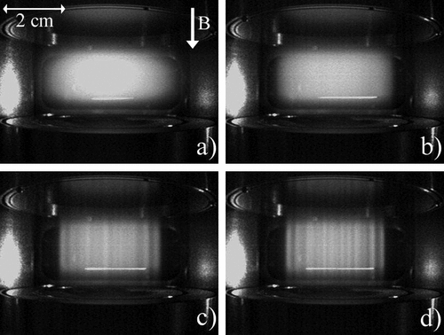
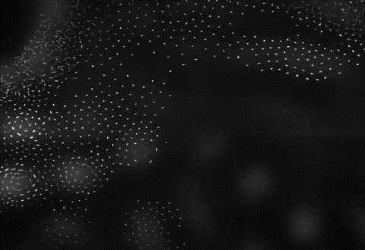
Filamentation at high magnetic fields
Observed in a 4 T, rf parallel-plate device at MPE by Schwabe and Konopka (PRL 106, 215004, 2011)
As the magnetic field was increased, the plasma broke up into filaments aligned along B.
The motion of the
particles in the
discharge changed
dramatically from a
collective rotation in
moderate fields to a
rotation around the
filaments.
We have been able to find conditions in MDPX where filamentation can be minimized.
B = 0.0 T
B = 0.5 T
Top view, with dust
B = 1.0 T
B = 1.6 T
Side-view images of plasma
emission, no dust.

Slide 24
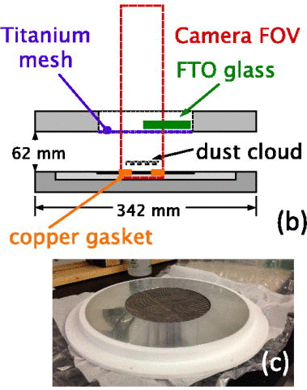
First, unexpected results from MDPX
MDPX operates with the rf power applied to the lower electrode, the chamber is grounded, and the upper electrode is electrically floating.
For viewing purposes, the upper electrode contains a fine titanium mesh
Dust particles (2 μm or 0.5 μm diameter) are introduced using a dust shaker. They are suspended 20 - 30 mm above the lower electrode
Suspension viewed from above using a 4 megapixel camera at 12.5 fps.
(63 mm)

Slide 25
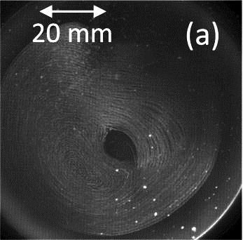
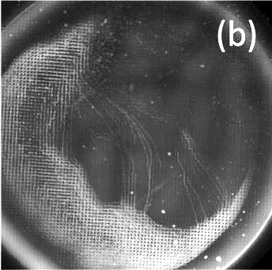
P = 145 mTorr
B = 2.0 T
2 micron
diameter
particles
P = 145 mTorr
B = 1.0 T
Intensity maxima for a sequence of 100
images showing particle trajectories over
approximately 8 s. The circular patters are
the result of E x B driven drifting ions that
transfer momentum to the dust particles
When B is increased to 2 T, a grid structure appears in the suspended dust particles. The grid structure has the identical spatial structure as the mesh in the upper electrode.

Slide 26
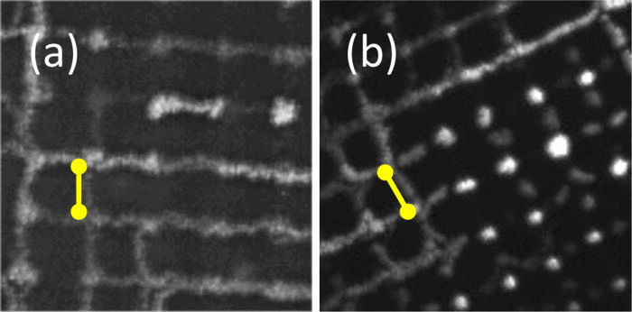
Close-up view of dust grid structure (125x125)
In both cases, the dust grid spacing is identical to the to the spacing of the mesh wires (0.635 mm)
Also, the width of the dust “grid lines” is the same as the diameter of the mesh wires.
➔ It appears that the dust grid structure “maps” to the spatial dimensions of the wire mesh.
2 μm particles,
B = 2 T
P = 145 mTorr
RF 2.5 W
0.5 μm particles,
B = 1.5 T
P = 53 mTorr
RF 2.5 W

Slide 27
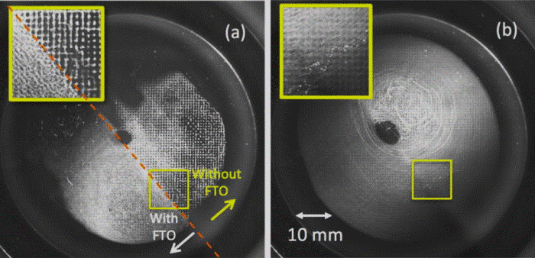
Additional observations
The dust grid structure is greatly suppressed in the region mapped to the FTO glass.
When the pressure was increased to 167 mTorr, the grid structure was suppressed over the entire region and the particles are freely circulating.
➔ The dust grid structure is strongly connected to the mesh.
RF 4 W, B = 1.5 T
P = 128 mTorr
2 μm particles
FTO glass plate
covering ½ of
the mesh
RF 4 W, B = 1.5 T
P = 167 mTorr
2 μm particles
FTO glass plate
covering ½ of
the mesh

Slide 28
What is the mechanism for the dust grid structure?
It appears that the floating mesh structure is somehow, over a distance of 3 – 4 cm, imprinted on the dust.
This is somewhat surprising given the collisional nature of the plasma (ion-neutral mfp » 0.6 mm, electron-neutral mfp » 8 mm)
Potentials can be mapped along magnetic fields over long distances in collisionless plasmas.
The effect clearly depends on the degree of magnetization and the collisionality of the plasma:
  grid structures are favored at higher magnetic fields,
  and lower pressures
Further experiments are in progress
Numerical simulations are needed to understand the effect

Slide 29
More Information
Thank you.
MDPX Device:
  http://psl.physics.auburn.edu/research/magnetized-dusty-plasmas.html
  Thomas et al, Plasma Phys. Control. Fus. 54, 124034 (2012)
  Thomas et al, J. Plasma Physics, 81, 345810206 (2015)
Grid structures
  Thomas et al, Phys. Plasmas 22, 030701 (2015)

